Slide 1

Presented By
Opoka John Modi Silvio
Go Kart Warehouse System: Operational Excellence Unleashed
The Go Kart Warehouse System is an enterprise-grade, full-stack application meticulously engineered to streamline the intricate operations of a professional go-karting facility. This system centralizes fleet management, automates maintenance scheduling, and optimizes inventory control, providing a robust platform for unparalleled operational efficiency.

Slide 2

Architectural Foundation: Decoupled & Resilient
The application employs a decoupled architecture, leveraging a Spring Boot backend and an Angular frontend. This design ensures high performance, maintainability, and a clear separation of concerns, critical for complex enterprise applications.
Presentation Layer
Service Layer
Angular 21: A reactive Single Page Application (SPA) managing state via RxJS for real-time UI feedback.
Spring Boot 3: Handles complex business logic, secures endpoints with JWT, and orchestrates RESTful APIs.
Data Layer
PostgreSQL/H2: Ensures persistent, ACID-compliant storage for all critical operational and archival data.

Slide 3

Robust Technical Specifications
The system is built upon a foundation of industry-leading technologies, ensuring scalability, security, and performance.
Backend Stack
Frontend Stack
Language: Java 21 (LTS)
Framework: Angular 15
Framework: Spring Boot 3.x
Reactive Streams: RxJS
Security: Spring Security with stateless JWT
Styling: Modern Design System, 12px Grid
Persistence: Spring Data JPA / Hibernate
Communication: HTTP Client with Global Error Interceptors
Build Tool: Apache Maven 3.x

Slide 4
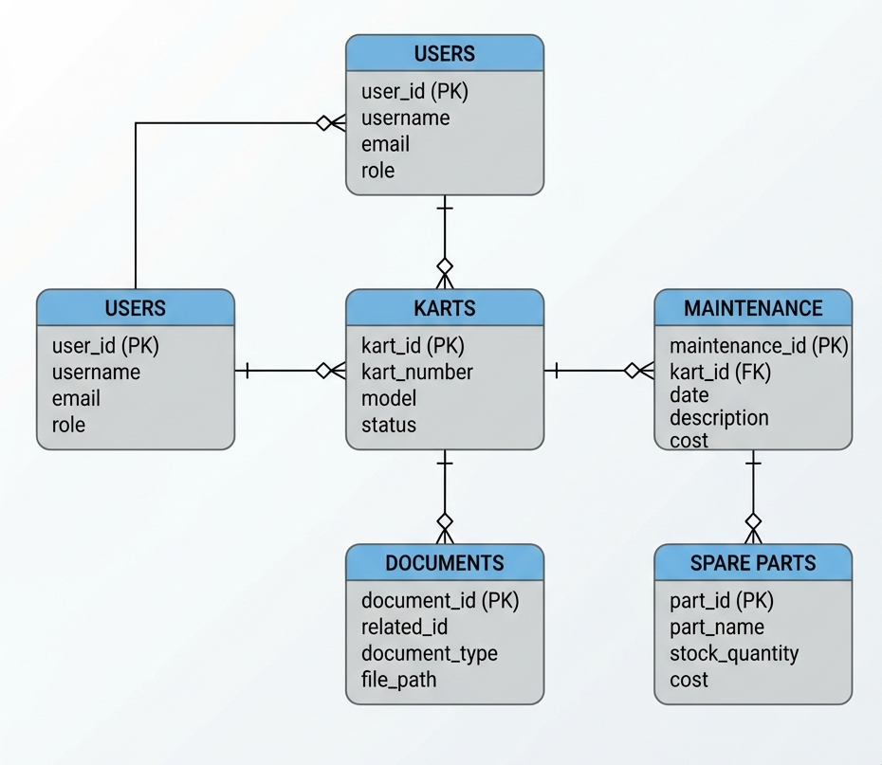
Database Design & Entity Relationships
The database schema is meticulously crafted to manage thousands of transactions across diverse operational domains. Clear entity relationships are established to ensure data integrity and facilitate efficient data retrieval for fleet, maintenance, and inventory management.

Slide 5

Recent Enhancements: Industrial Premium Standards
Following a comprehensive technical audit, the system has undergone significant upgrades, elevating it to "Industrial Premium" standards with enhanced user experience and visual clarity.
Global Error & Loading UX
High-Scannability UI Audit
Zero-Silent Failure: A Global ErrorInterceptor ensures all API failures are reported to the user via Toast notifications.
Stat Box Layout: Cluttered text lists replaced with modern "Stat Box" components for Fleet and Analytics.
Universal Feedback: A global loading service provides visual overlays during heavy operations and report generation.
12px Grid Standard: Implemented consistent 12px padding in all data tables for reduced visual density.
Dark Theme Overhaul: Unified aesthetic across all pages, including Maintenance and Task modules.

Slide 6

Core Feature Analysis: Fleet & Maintenance
The system offers comprehensive fleet management capabilities and ensures rigorous maintenance and safety accountability.
Fleet Management
Maintenance & Safety Accountability
Real-time oversight of the entire go-kart fleet.
Manager Verification Loop: Maintenance logs require digital verification by a Manager before karts return to service.
Karts tracked by status: Available, Maintenance, Crashed, Retired.
Individual engine hours recorded for proactive servicing.
Audit Logs: Every status change and system action logged with timestamp and user ID for forensic review.

Slide 7

Smart Inventory & Advanced Task Assignment
1
2
Smart Inventory
Advanced Task Assignment System
Real-time Deduction: Part quantities automatically deducted from stock upon use in maintenance.
Role-Based Hierarchy: Admins assign tasks to all users; Managers to Staff.
Threshold Alerts: High-contrast visual warnings trigger when stock falls below critical levels.
Assigned Fulfillment: Only the Assignee can mark a task "DONE," enforcing direct responsibility.
Private Workstreams: Users see only assigned or created tasks, reducing operational noise.
Fulfillment Banner: "Perfectly Fulfilled" success banner appears when a user's queue is clear.

Slide 8




Deployment & Verification
The application is fully containerized, rigorously tested, and deployed with robust security measures to ensure reliable and secure operations.
Containerized Deployment
100% Green Build Status
Utilizing Docker & Docker Compose for efficient orchestration and portability.
Maven & Angular Production builds consistently pass, ensuring high quality and stability.
Stateless RBAC Security
Role-Based Access Control enforced at every endpoint for maximum data protection.

Slide 9


Future Roadmap: Strategic Enhancements
Our vision extends to integrating cutting-edge technologies and expanding functionalities to further optimize go-kart operations and customer experience.
Real-time Telemetry Integration
Bluetooth/API integration with kart sensors for live data.
Monitoring of speed, engine temperature, and battery.
Predictive maintenance alerts based on sensor data.
Mobile Applications
React Native cross-platform app for mechanics.
Barcode/QR code scanning for parts and karts.
Offline capability with sync when online.
Advanced Analytics & ML
Predictive failure analysis using historical data.
Optimal maintenance scheduling algorithms.
Cost-benefit analysis for part replacement vs. repair.
Customer Portal
Booking integration for kart sessions.
Customer-facing maintenance status updates.
Incident reporting by customers for prompt resolution.

Slide 10

Conclusion: A Production-Ready Platform
The Go Kart Warehouse System stands as a robust, production-ready platform, meticulously designed to meet the demanding needs of professional racing environments. Its integration of a strict safety verification loop and an advanced hierarchical task system positions it as a top-tier management solution.
Key Strengths:
Operational Efficiency: Streamlined processes from fleet to inventory.
Enhanced Accountability: Rigorous task assignment and verification.
Robust Architecture: Scalable, secure, and high-performance.
Future-Proof: Clear roadmap for continued innovation and growth.

